Slide 1
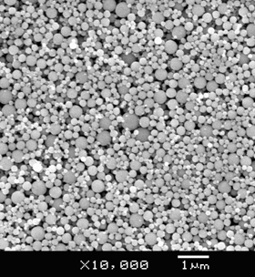
Synthesis and Characterization of Environmentally Benign Cu/PVA Nanocomposites
Kim Lykens, Stebbins High School
Todd Hamilton, Academy of World Languages
Faculty Mentors: Dr. George Sorial &
Dr. Margaret Kupferle
Graduate Research Assistant: Ayenachew Tegenaw
Grant #EEC-1404766
Notes:
Both

Slide 2
Table of Contents
Abstract
Introduction
Literature Review
Goals & Objectives
Research Design (Methods, Training, Results)
VI. Research Conclusions
VII. Unit Topics
Notes:
Kim

Slide 3
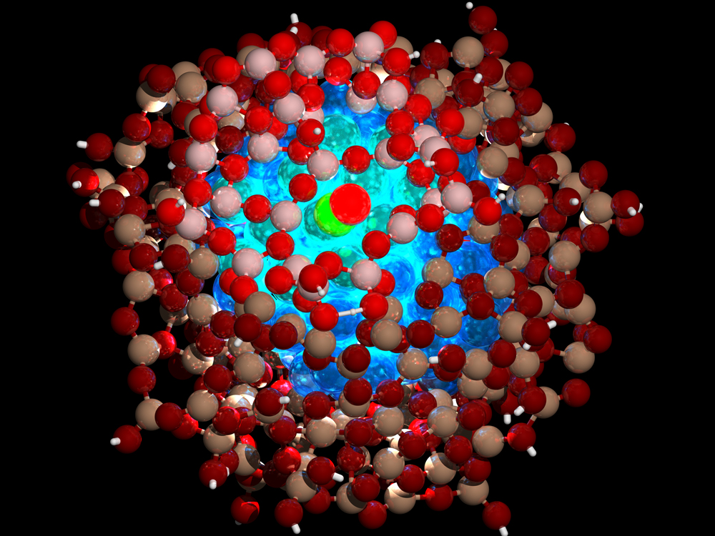
Abstract
Copper/polyvinyl alcohol (Cu/PVA) nanocomposites were synthesized using chemical reduction method
Characterized by various microscopy and spectroscopy techniques
Stability analysis under various environmental conditions
Rate of catalytic degradation for methylene blue pollutant
Nanoparticle
http://sustainable-nano.com/2013/07/17/nanoparticles-with-your-coffee-a-java-infused-science-experiment/
Notes:
Kim
Atoms, molecules, or clusters (Chemical reducation method)

Slide 4
Introduction
http://www.wichlab.com/research/
Nanoparticles:
Between 1-100nm in size at least in one dimension
Notes:
Kim

Slide 5
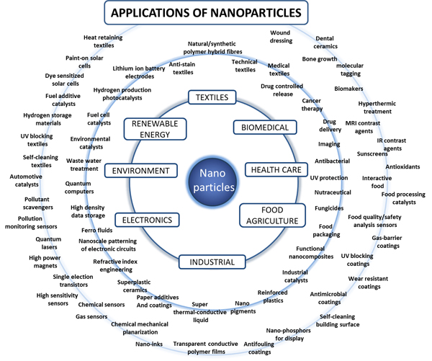
Introduction (cont.)
Nanoparticles:
High surface-area-to-volume ratio
Unique physical/chemical properties
Novel applications
Concerns:
Environmental toxicity (hydrosphere, lithosphere, atmosphere, biosphere)
Ethical concern
Copper (Cu) Nanoparticles:
Biocide, catalyst, antimicrobial
Economical and abundant
http://people.forestry.oregonstate.edu
Notes:
Kim catalytic behavior
Production of Chemical Weapons

Slide 6
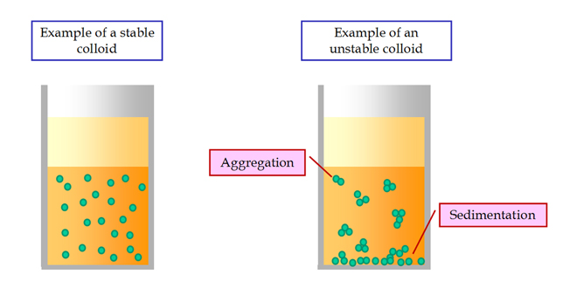
Literature Review
Synthesis Approach (Top-Down & Bottom-Up):
Pieces of metal are milled into smaller particles
Chemically synthesizing nanoparticles (Borm et al., 2006)
Synthesizing Nanoparticles:
Electrolyte salt and Cu precursor
Stabilizing/capping agent (Ramesh et al., 2012)
Stabilization Mechanisms
Electrostatic
Steric
Electrosteric (Fritz et al., 2002)
Polyvinyl alcohol (PVA):
Stabilizing agent
Non-toxic, biodegradable, water-solubale (Patachia, 2003)
https://en.wikipedia.org/wiki/Colloid
Notes:
Kim
Agglomeration influences the:
Size of nanoparticles
Physicochemical properties (Borm et al., 2006)

Slide 7
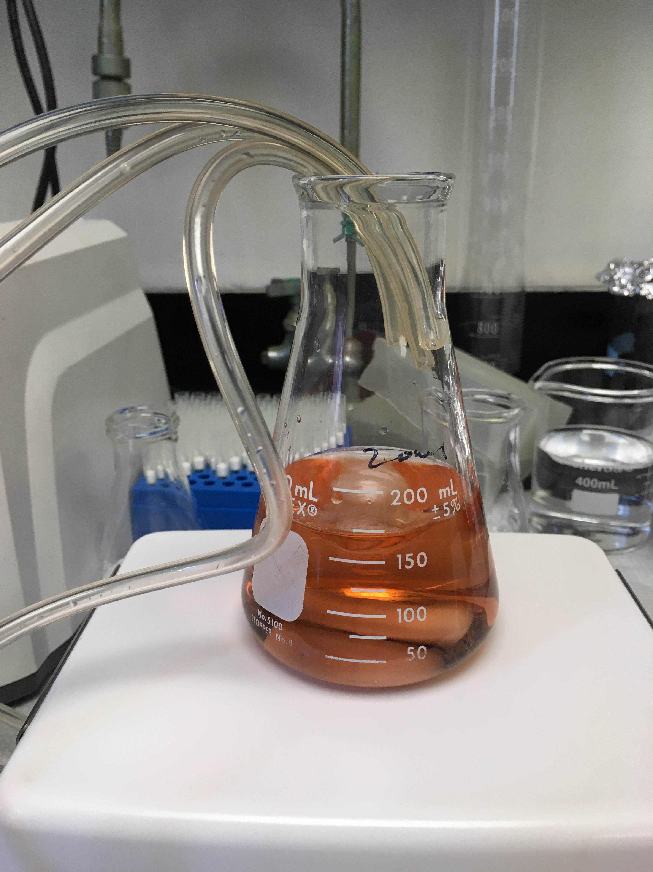
Goal and Objectives
Goal:
Synthesize environmentally benign Cu/PVA nanocomposites
Objectives:
Synthesis and characterization
Assessing impact of environmental factors (pH, ionic strength, electrolyte valence, humic acid) on particle size
Degradation of organic pollutant under UV light
Notes:
Kim
Monovalent (NaCl)– one charge +1
Divalent (CaCl2)—two charge +2
Ionic strength= intensity of ions (concentration)

Slide 8
Research Design
Analytical Design
Synthesis
-Carbonate
-Iodine
-Hydroxide
Notes:
Todd

Slide 9
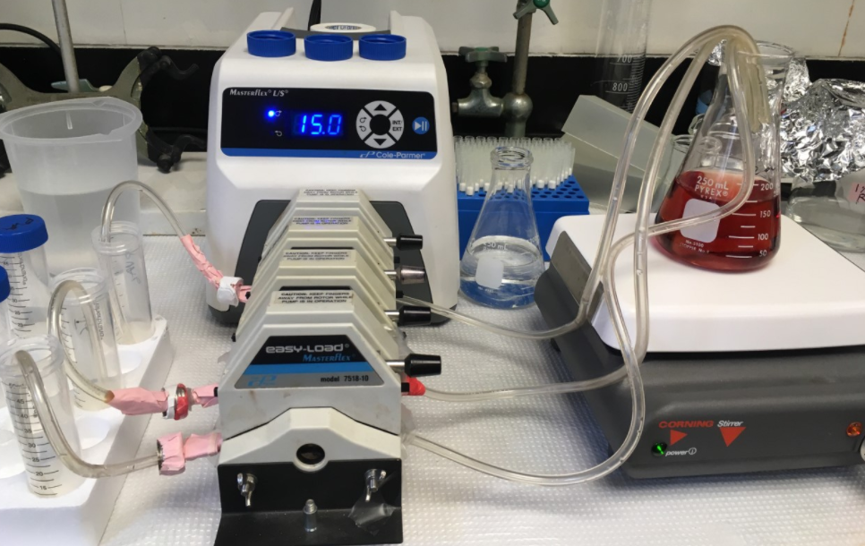
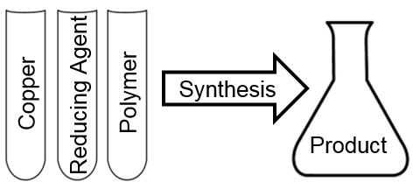
Nanoparticle Synthesis
Electrolyte
Notes:
Todd

Slide 10
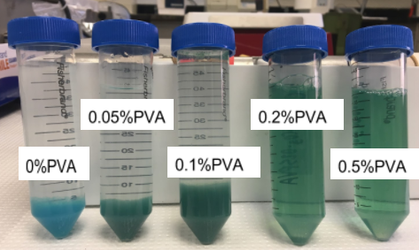
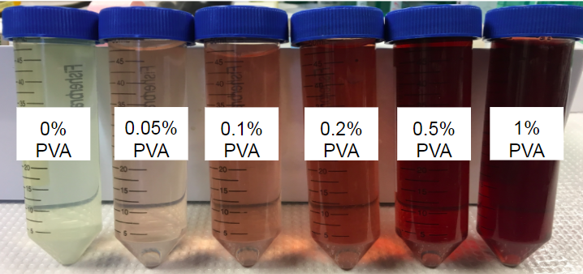
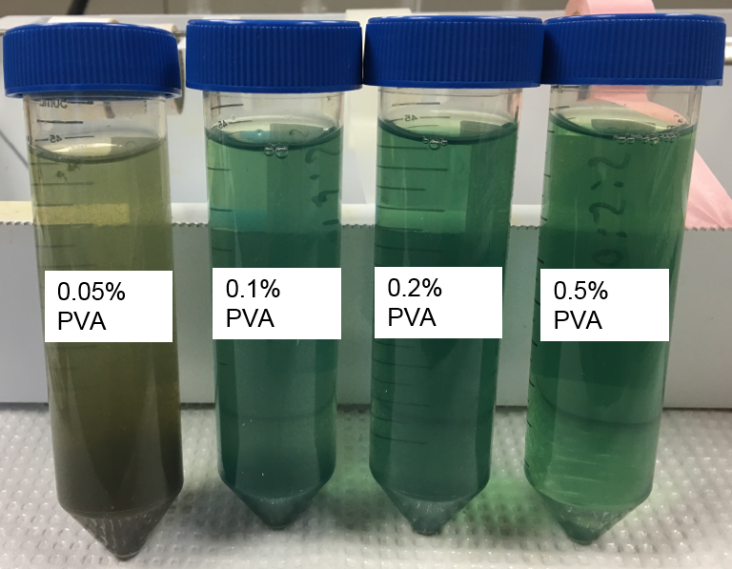
Nanoparticle Synthesis
Sodium Carbonate
Sodium Iodide
Sodium Hydroxide
-Aggregation
-Small size at high PVA
-Unstable peak
-Poor TEM imaging
-No aggregation
-Small size
-Stable peak -Excellent TEM imaging
-Aggregation
-Small size at high PVA
-Unstable peak -Poor TEM imaging
CuCl₂ + Na₂CO₃ → CuCO₃ + 2NaCl
CuCl₂ + 2NaI → CuI₂ + 2NaCl
CuCl₂ + 2NaOH- → CuOH₂ + 2NaCl
Notes:
Todd

Slide 11
Research Design
Analytical Design
Synthesis
-Carbonate
-Iodine
-Hydroxide
Characterization
-HDD
-UV-Vis
-TEM/EDX
Notes:
Todd

Slide 12
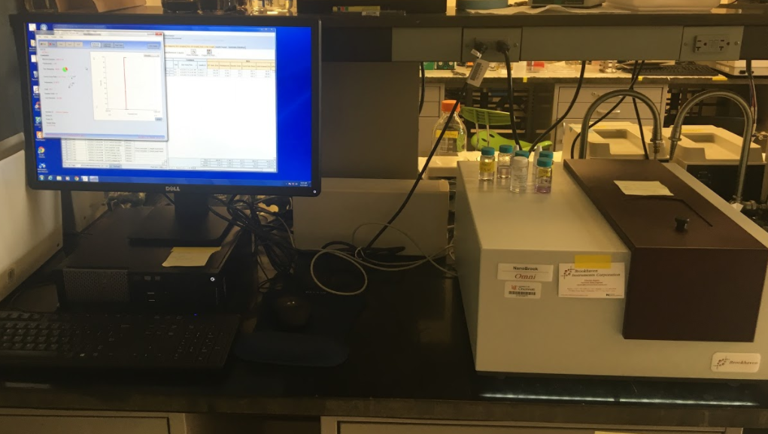
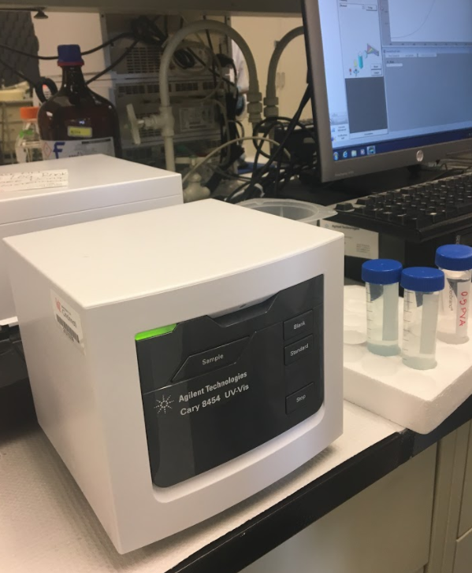
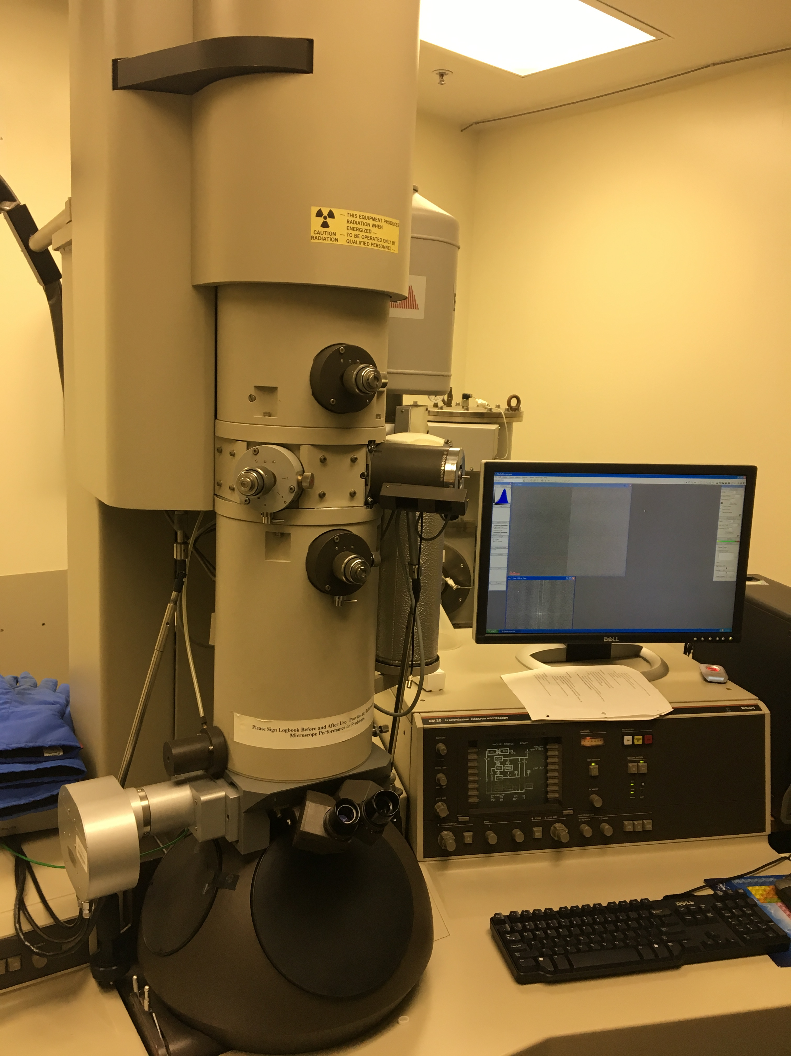
Nanoparticle Characterization
HDD (Hydrodynamic Diameter)
UV-Visible Spectroscopy
TEM Imaging & EDX
Size (nm)
0% PVA-1% PVA
Absorbance of light
Wavelengths & Intensity
Visualize particles
Element recognition
Notes:
Todd
Morphology (size, shape, and dispersity)
Confirms elemental Copper spectrum

Slide 13
HDD Results
PVA (%) | Size (nm)
0 | 5000
0.05 | 6200
0.1 | 75
0.2 | 520
0.5 | 505
1 | 840
Notes:
Kim
Hydrodynamic diameter (PVA)

Slide 14
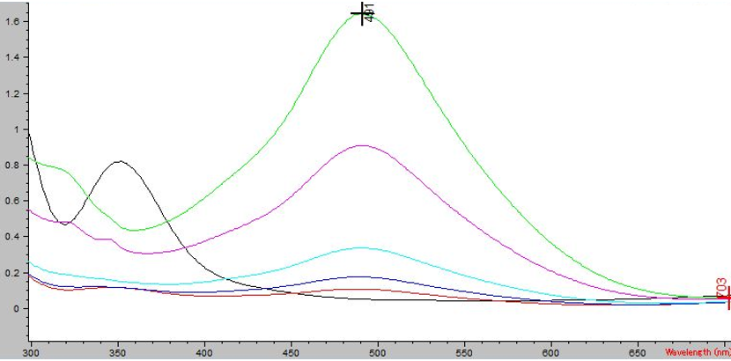
UV-Vis Results
Absorbance and Wavelengths of Cu/PVA Nanocomposites With Varying Amounts of PVA
Absorbance (AU)
Copper Nanoparticles
~570 nm
Ionic Copper
~800 nm
PVA
~276nm
Wavelength (nm)
Notes:
Kim
Checked using TEM

Slide 15
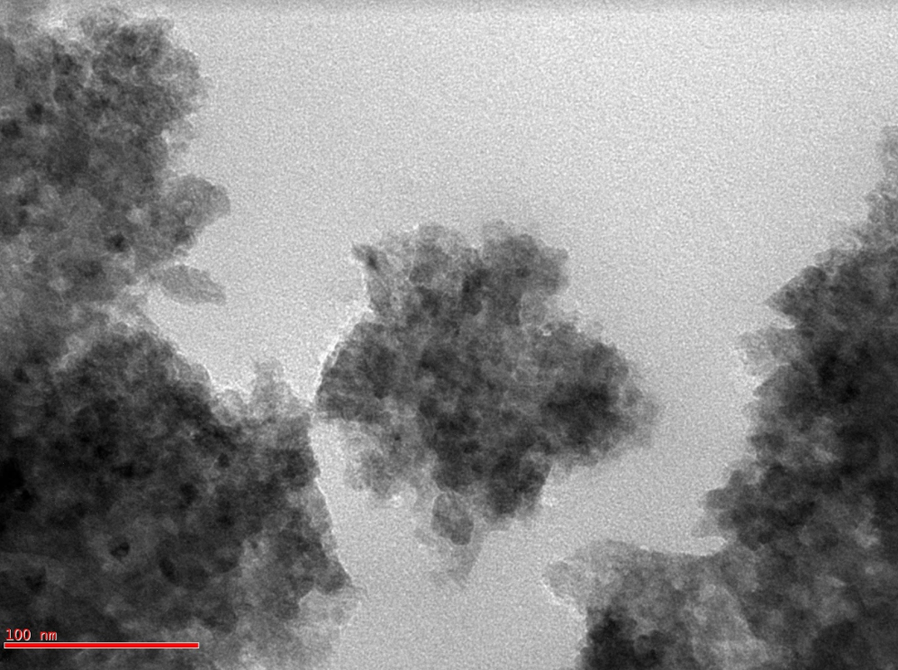
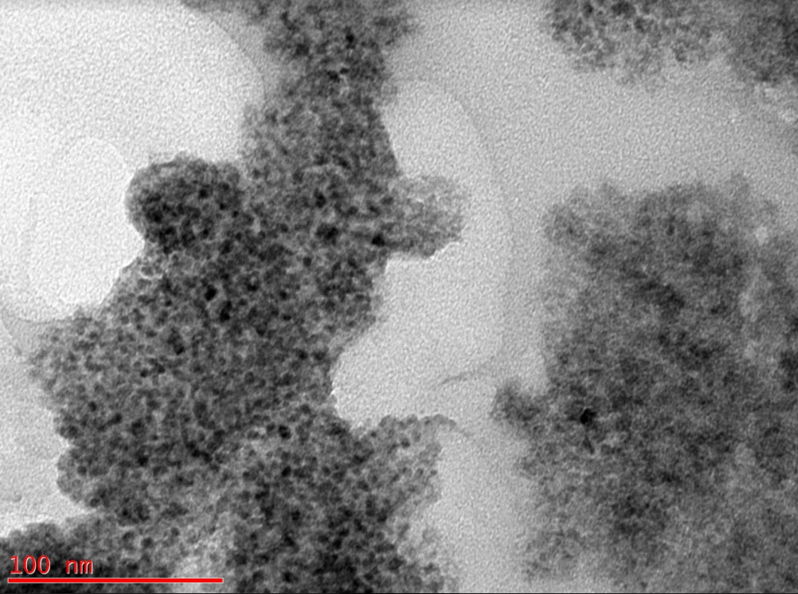
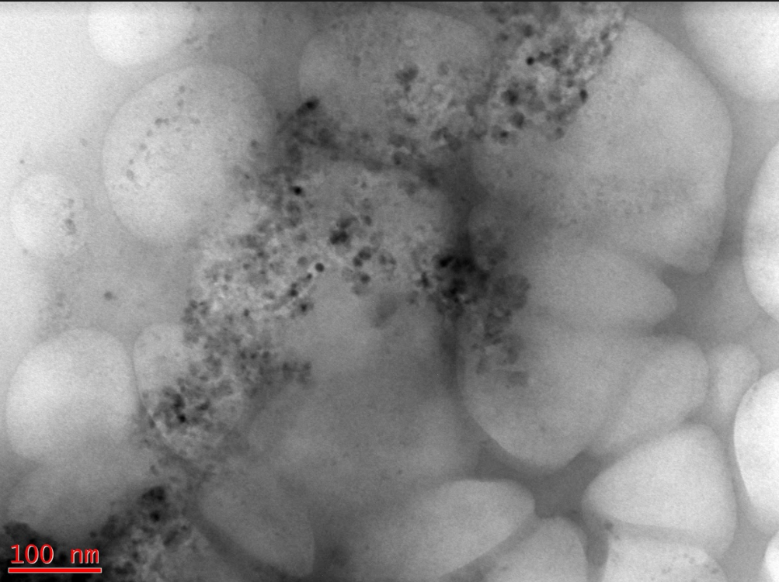
TEM Results
Polymer
Cluster of nanoparticles
Polymer
100K X
100K X
100K X
0.1 PVA
0.2 PVA
0.5 PVA
Notes:
Todd
5 nm
Sphere
Mono = same size
Poly = different size

Slide 16
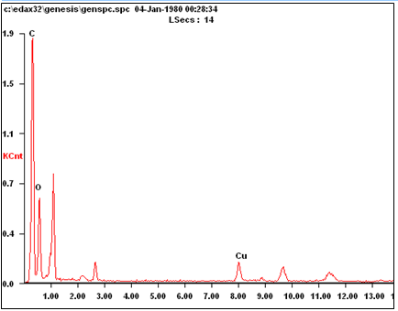
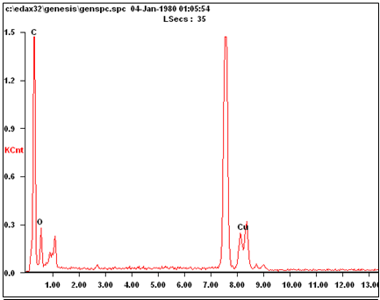
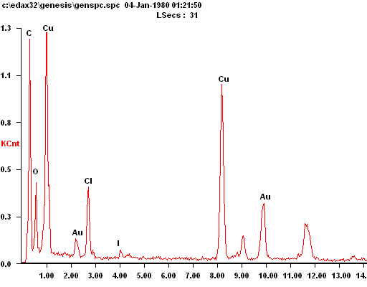
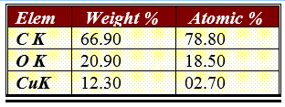
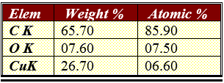
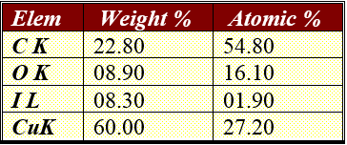
EDX Results
Copper Carbonate 0.2 PVA:
Elements Present in Sample
Copper Hydroxide 0.2 PVA:
Elements Present in Sample
Copper Iodide 0.1 PVA:
Elements Present in Sample
Notes:
Todd

Slide 17
Research Design
Analytical Design
Synthesis
-Carbonate
-Iodine
-Hydroxide
Characterization
-HDD
-UV-Vis
-TEM/EDX
-Metal Analysis
Impact of Environmental Factors
pH, ionic strength, humic acid
Degradation of Organic Pollutants
Notes:
Kim

Slide 18
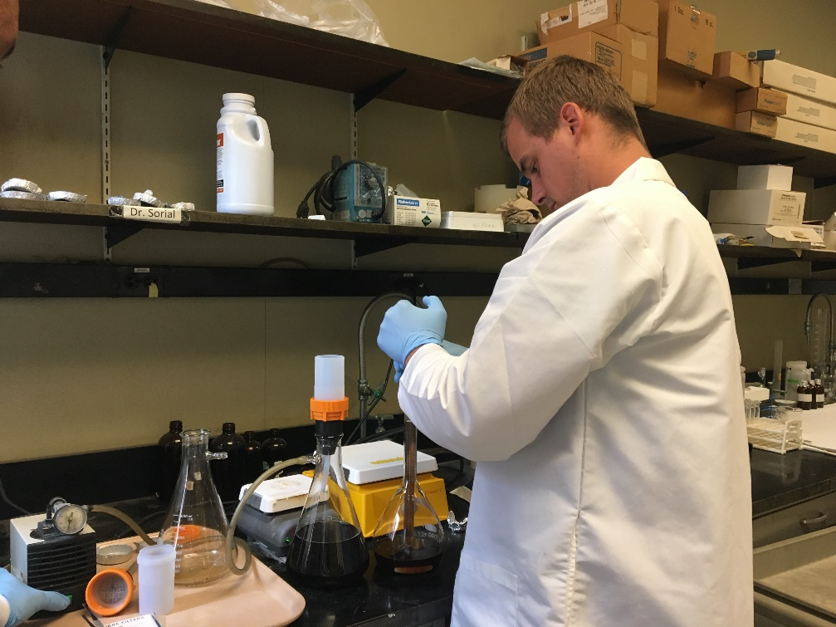
Environmental Factors
Ionic strength (1, 10, 100 mM)
Eletrolyte valence (monovalent & divalent)
Humic Acid (0, 5, 20 mg/L)
pH (5, 7, 9)
Notes:
Kim
Size (HDD)

Slide 19
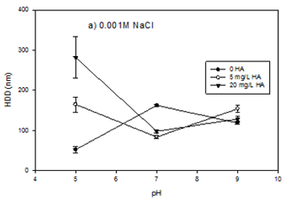
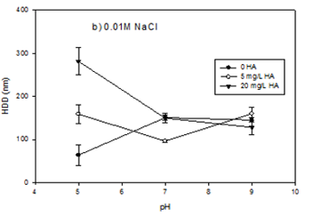
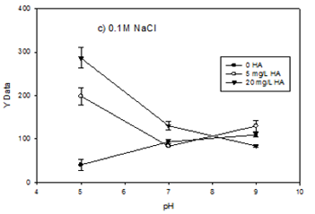
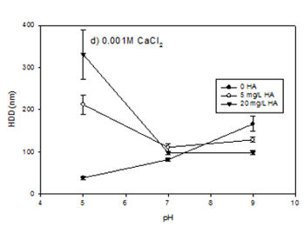
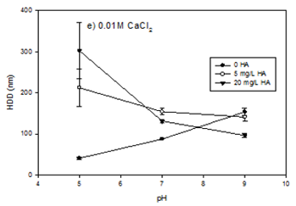
Impact of Environmental Factors
Notes:
Kim

Slide 20
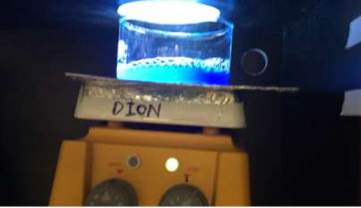
Methylene Blue Degradation
Methylene blue (50 µM)
Cu/PVA (62.5 – 500 mg/L)
UV Light, Room, Dark
UV-Vis Spectroscopy
To what extent will Cu/PVA nanocomposites degrade organic pollutants?
Notes:
Todd
2 ml filtered sample at 0 30 60 120
Model of organic pollutants
Decrease in absorbance = degredation

Slide 21
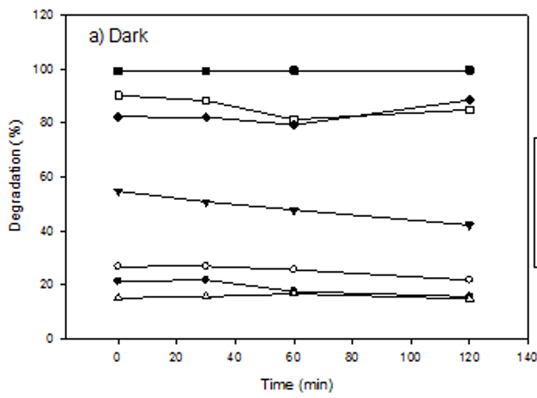
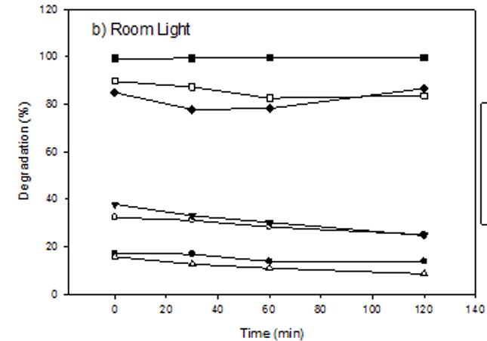
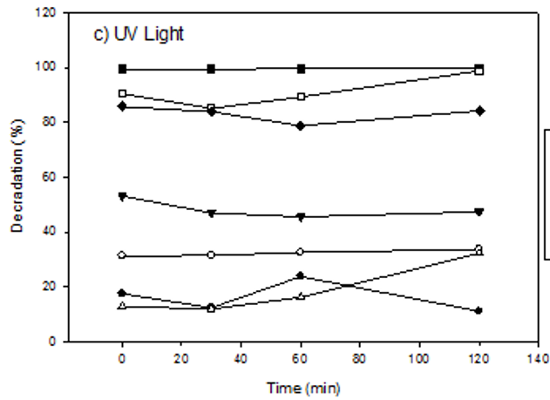
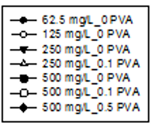
Degradation Results
500 mg/L most successful
Catalytic, not photocatalytic
Degradation rate not significant
Notes:
Todd

Slide 22
Research Conclusions
Goal:
Synthesize environmentally benign Cu/PVA nanocomposites
Conclusions:
Stability increases with PVA polymer
TEM images show nanoparticles with sizes less than 5 nm
The EDX provided a confirmation that Cu was present in the Cu-based nanoparticles
Stable suspensions at pH 7 and above in all environmental conditions
Potential application to degrade organic pollutants in high Cu concentrations
Notes:
Kim

Slide 23
Todd Hamilton: CBL Unit
Topic: Water Filtration
Essential Question: How can water be filtered using rocks, minerals, and soil?
Challenge: Create a water filtration system using only materials found in nature to survive dehydration while stranded in the wild.
Notes:
Todd

Slide 24
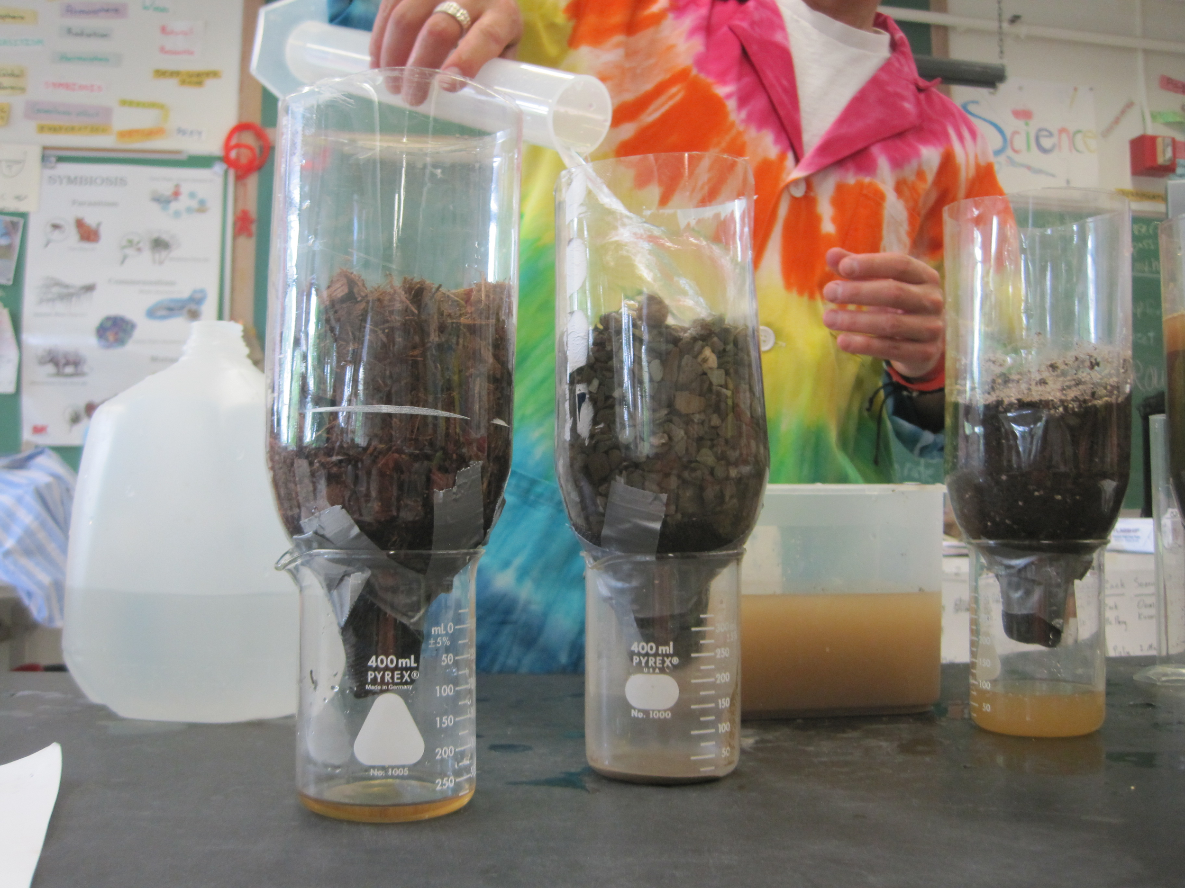
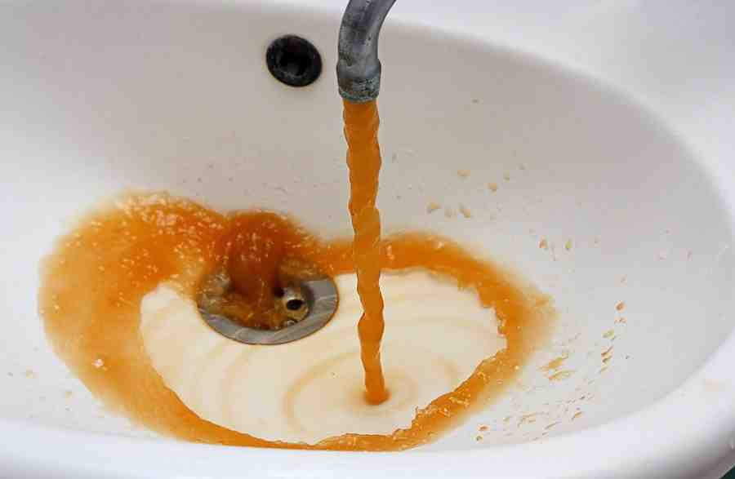
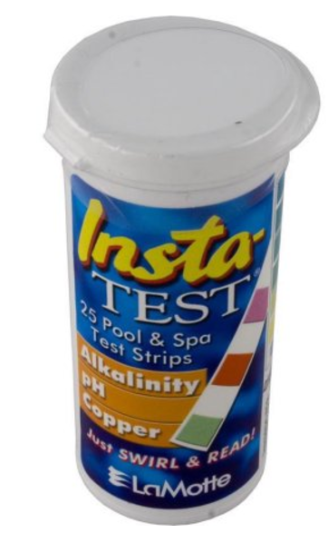
Kim Lykens: CBL Unit
Essential
Question
EDP
Big Idea
Water Contamination
How does metal in our water affect human health?
How can we prevent metals from leaching into water?
How do the metals in drinking water in Dayton affect our quality of life?
Reducing Cu Leaching into groundwater
Notes:
Kim

Slide 25
Bibliography
Borm, P., Robbins, D., Haubold, S., Kuhlbusch, T., Fissan, H., Donaldson, K., Schins, R., Stone, V., Kreyling, W., Lademann, J., Krutmann, J., Warheit, D., Oberdorster, E., 2006. The potential risks of nanoparticles: a review carried out for ECETOC. Particle Fibre Toxicol. 3, 11.
Fritz, G., Volker, S., Willenbacher, N., & Wagner, N.J. (2002). Electrostatic stabilization of colloidal dispersions. Langmur, 18(16, 6381-6390.
Patachia S. (2003). Blends based on poly (vinyl alcohol) and the products based on this polymer. In Handbook of Polymer Blends and Composites, Vasile C., Kulshreshtha A.K. (Eds.), RAPRA Technology Ltd, Shrewsbury, UK, 285-364.
Ramesh, C., Hariprasad, M., Ragunathan, V., and Jayakumar, N. (2012). “A novel route for synthesis and characterization of green Cu2O/PVA nano composites.” European Journal of Applied Engineering and Scientific Research, 1(4), 201-206.
Notes:
Both

Slide 26
Questions?
Notes:
Both

